Slide 1
Integrating Online & Offline Resources
for elementary Chinese
Second Language Learners
小学第二语言中文课堂
线上线下资源综合运用
Chee Hock Tan

Slide 2


Acknowledgement of Country 致敬国家
We acknowledge the Larrakia people, the Traditional Owner of this land and pay respect to the Elders, past, present and future for they hold the memories, the traditions, the culture and hopes of Aboriginal Australia and of those who educate their children in this area. We show respect for their history, their culture and our shared future.
我们感谢拉拉基亚人，这片土地的传统拥有者，向他们的祖先、向拥有回忆、传统、文化和希望的澳大利亚原住民前辈、同辈和晚辈们以及在这片土地上培育后代子孙的人表示敬意。我们尊重他们的历史、文化和我们共同的未来。我们将永远记住，这片土地现在是、过去是并将永远是传统原住民的土地。

Slide 3
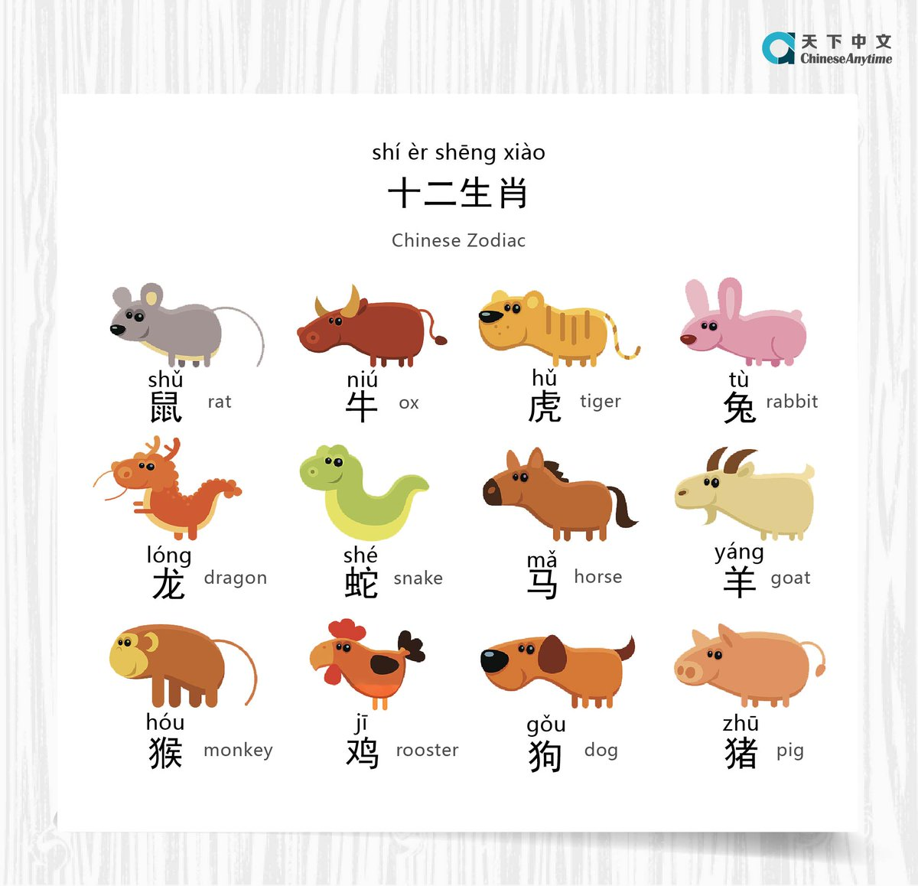

Slide 4
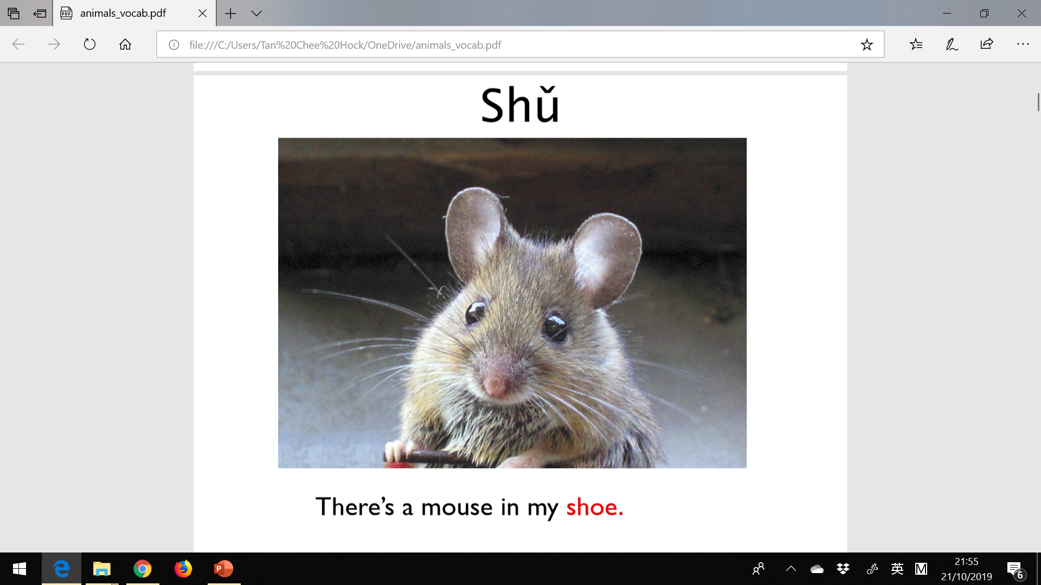

Slide 5
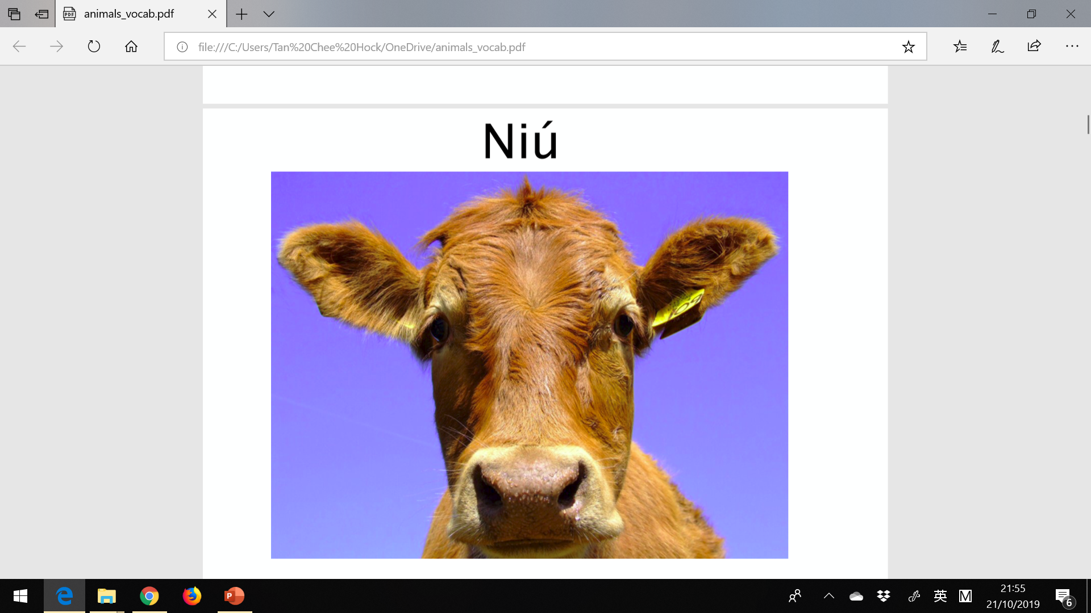
a New bottle of milk

Slide 6
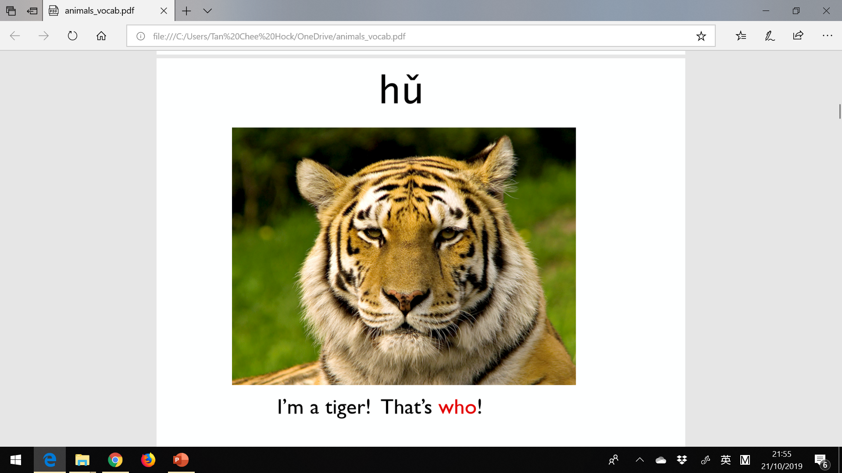

Slide 7
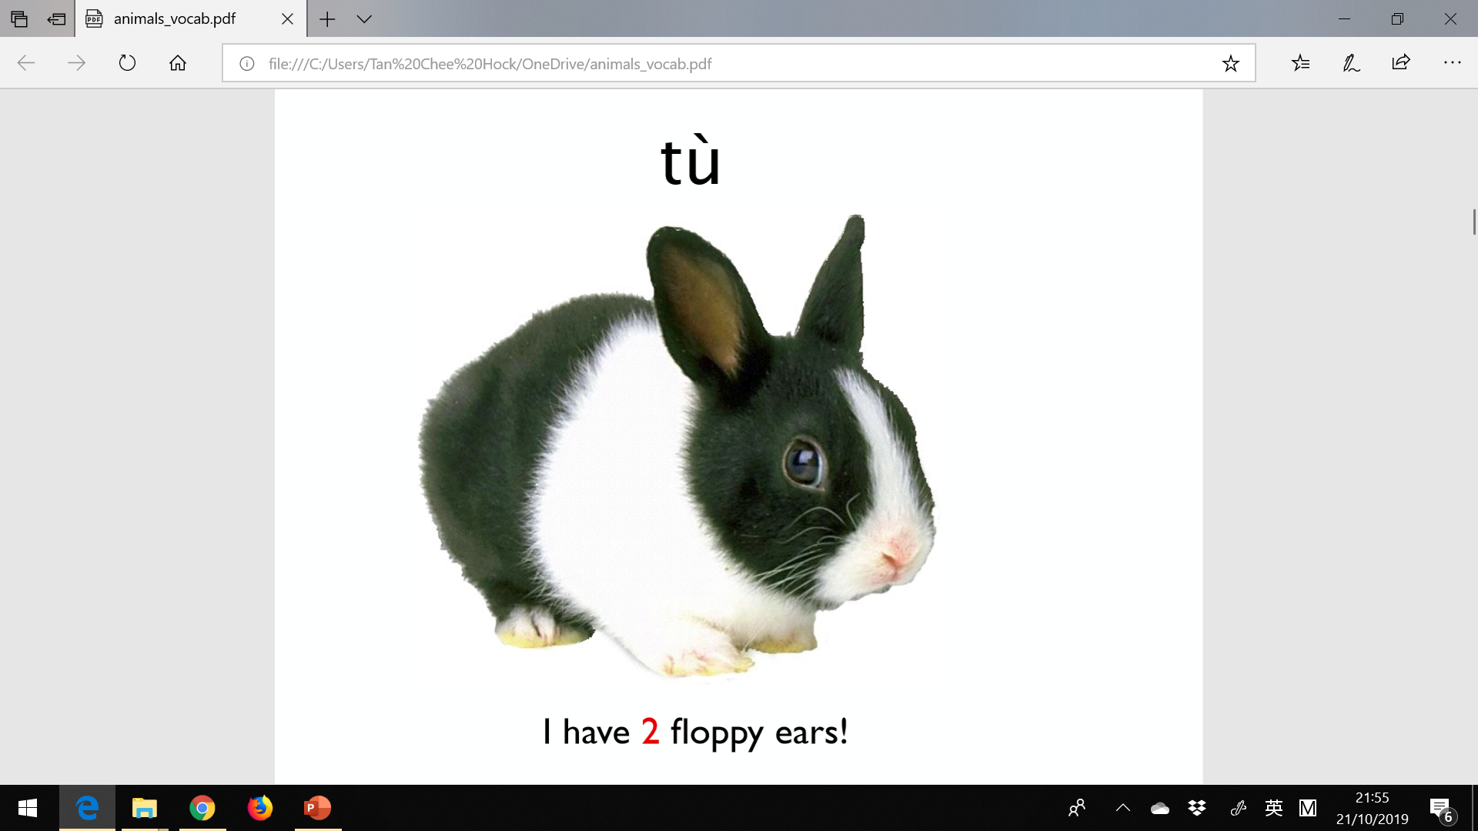

Slide 8
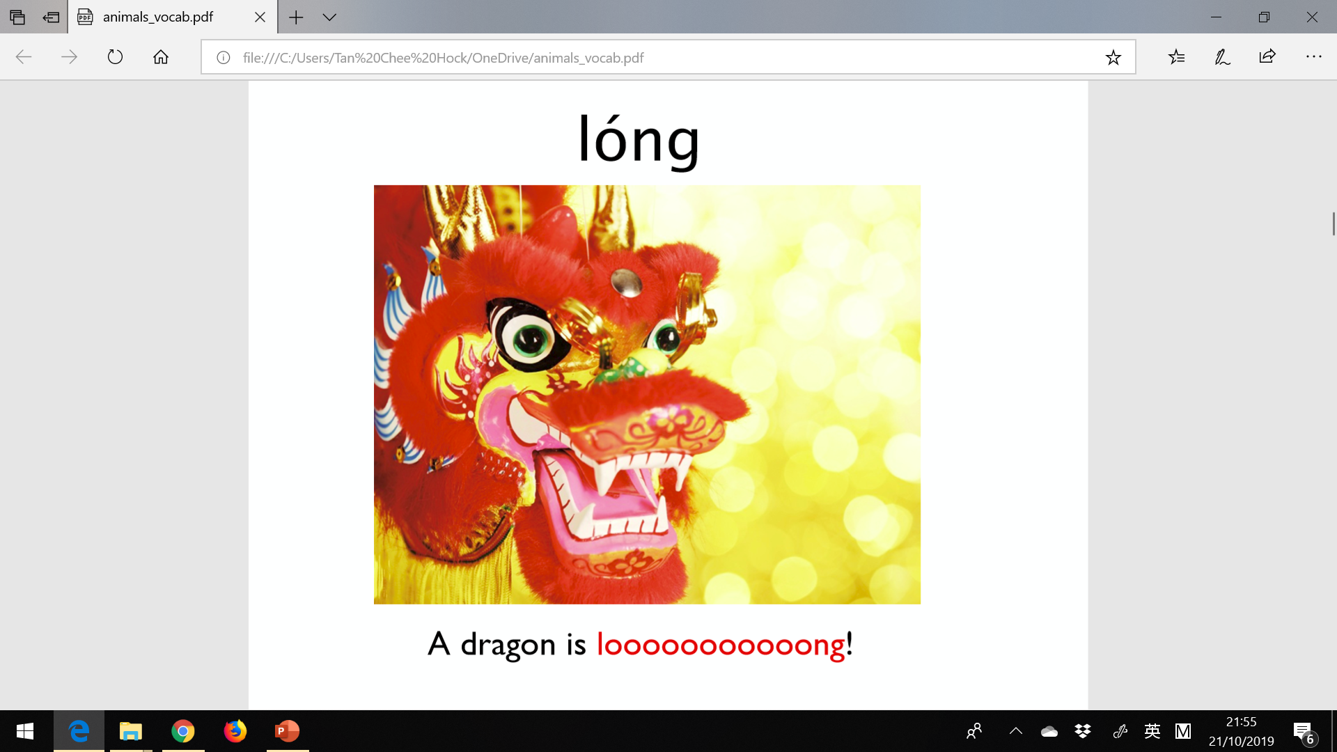

Slide 9
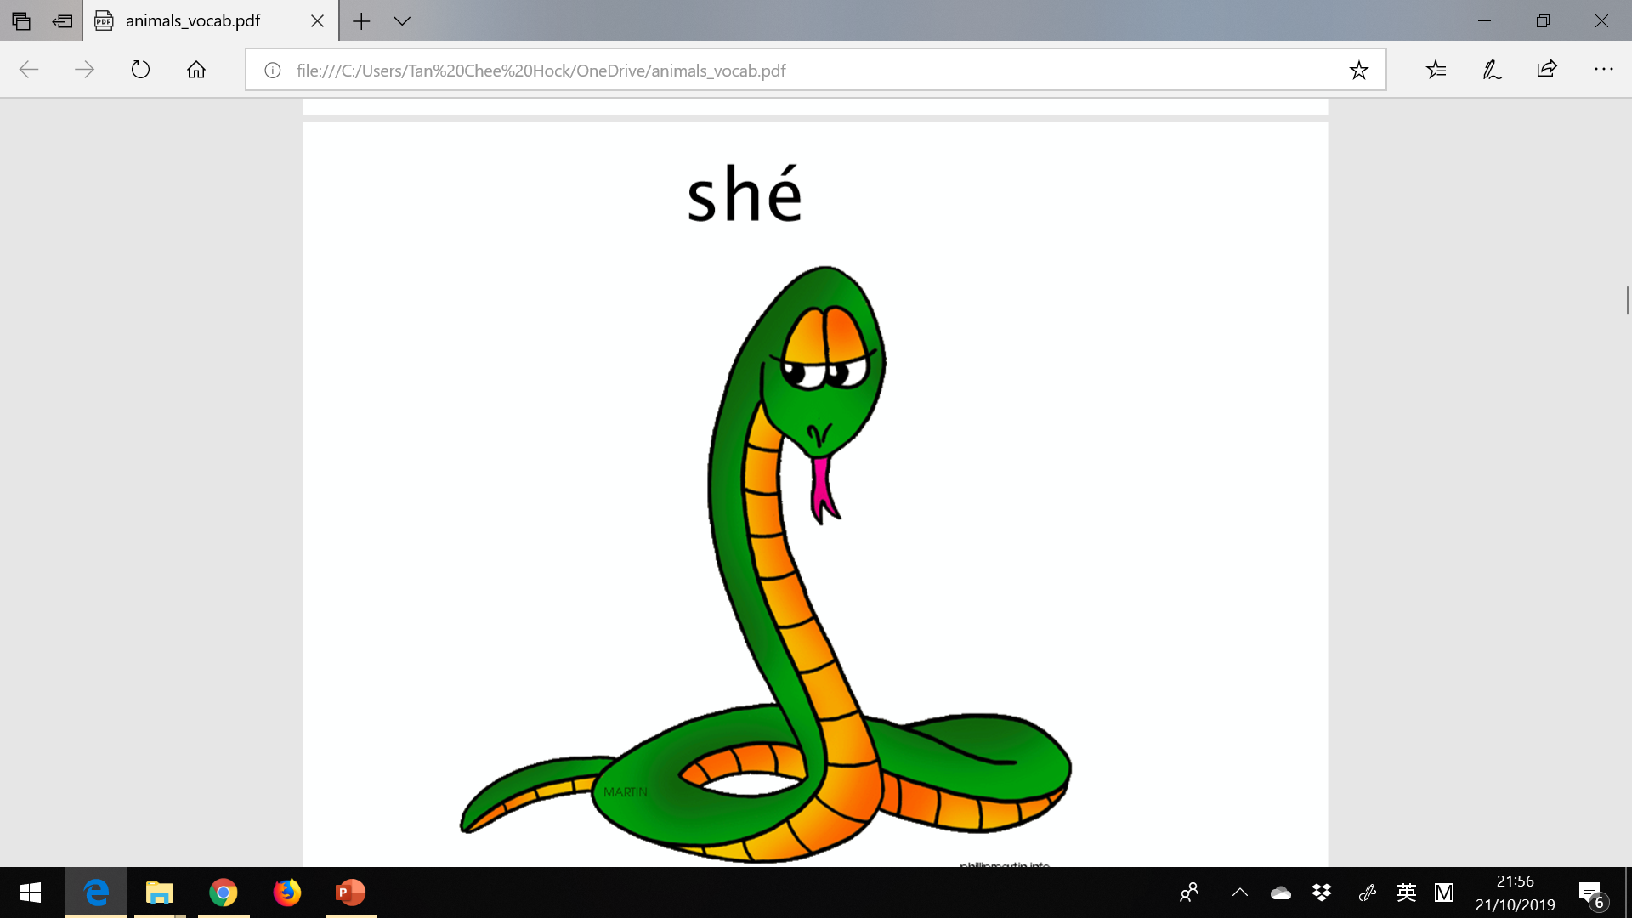

Slide 10
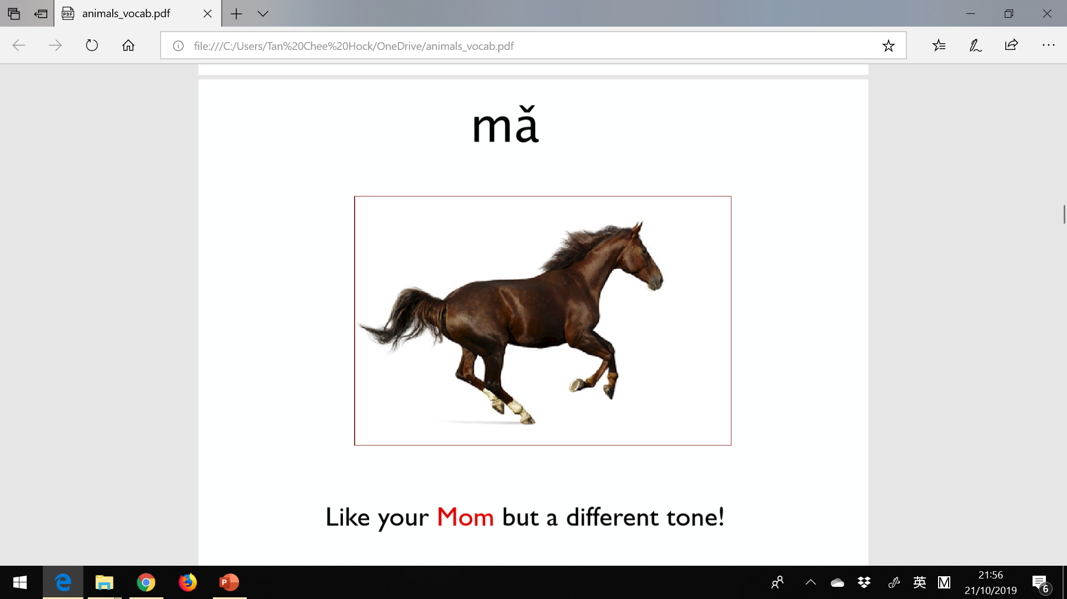

Slide 11
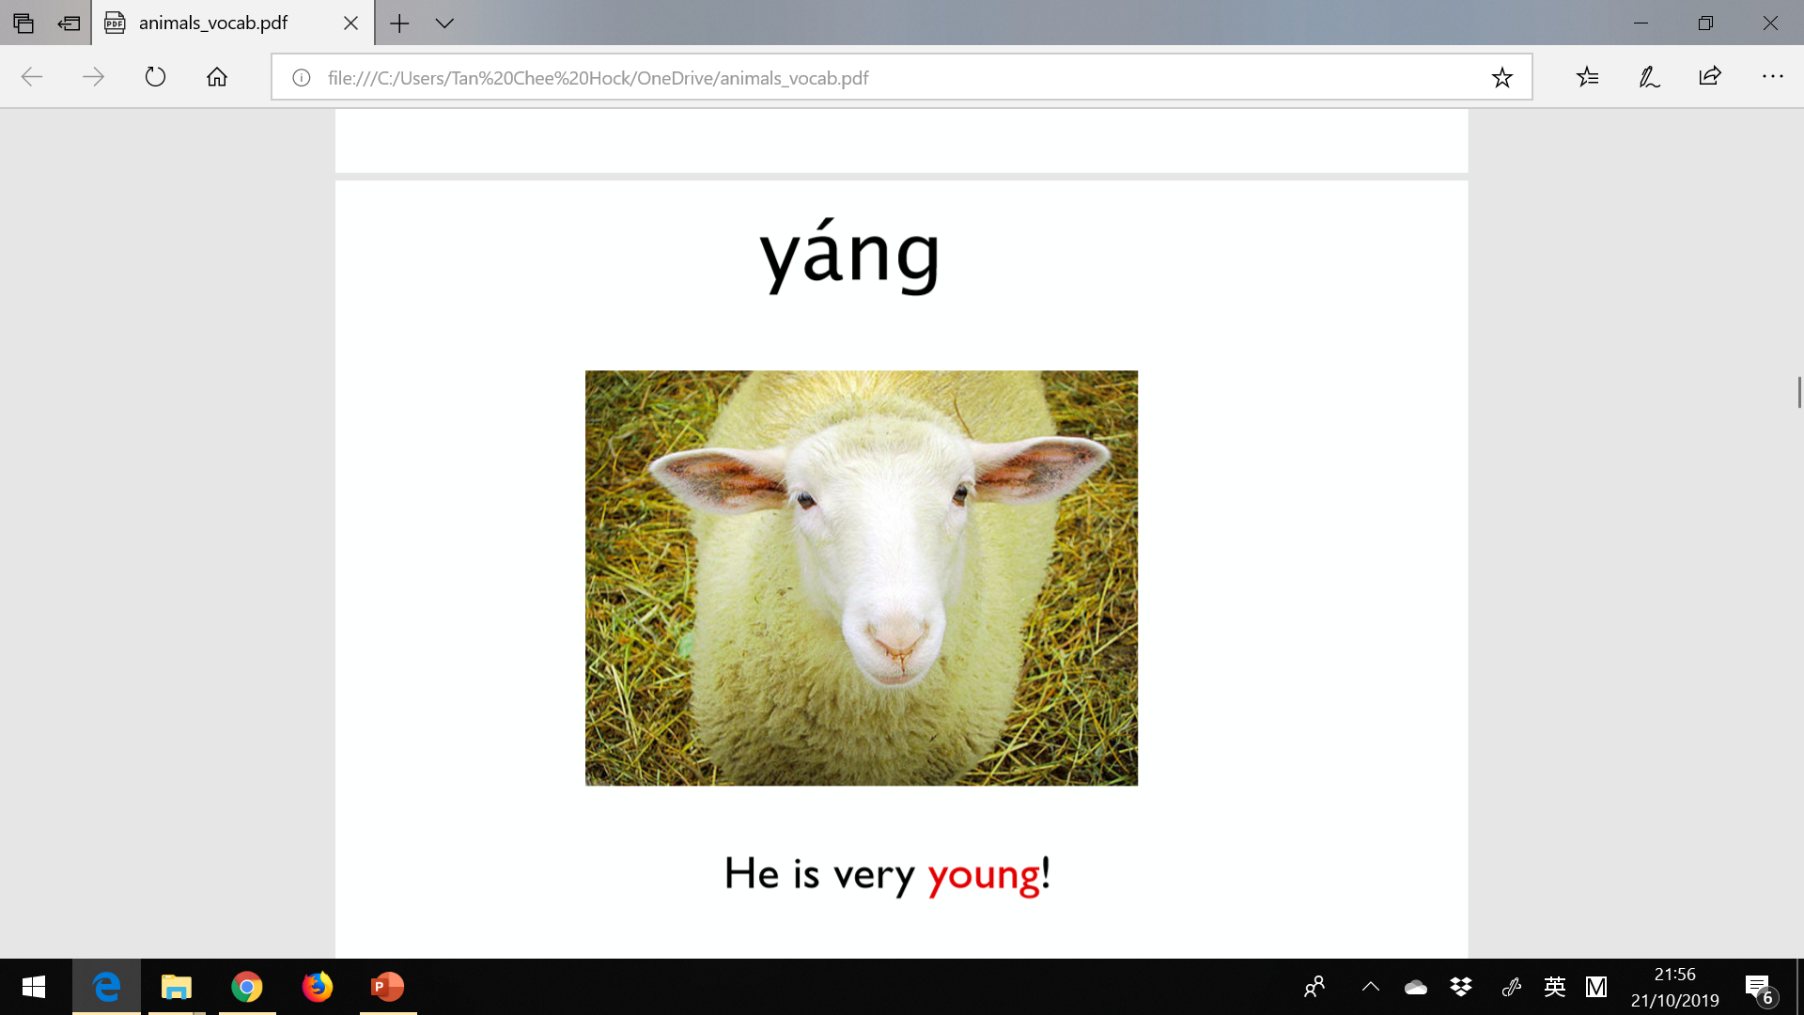

Slide 12
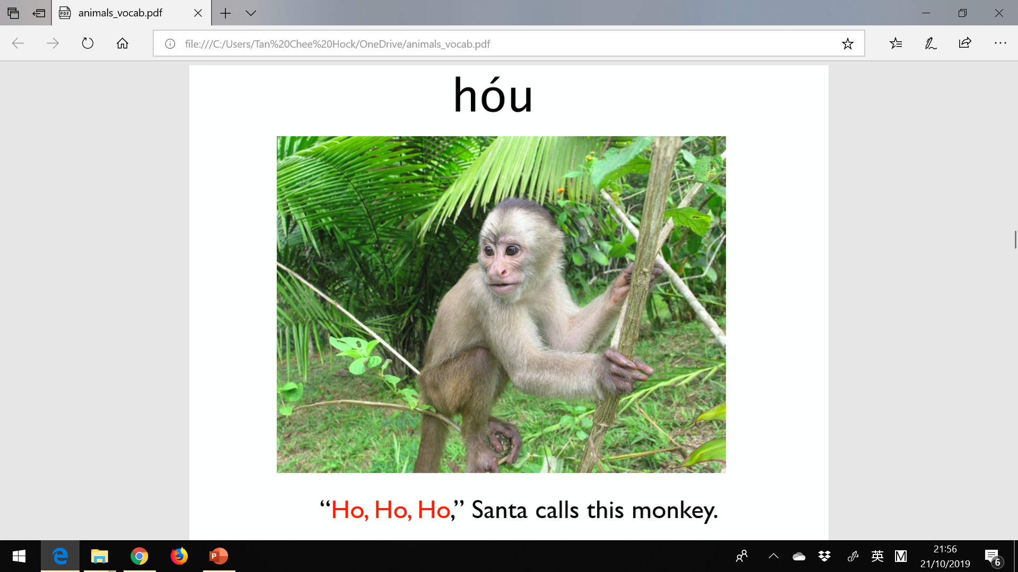

Slide 13
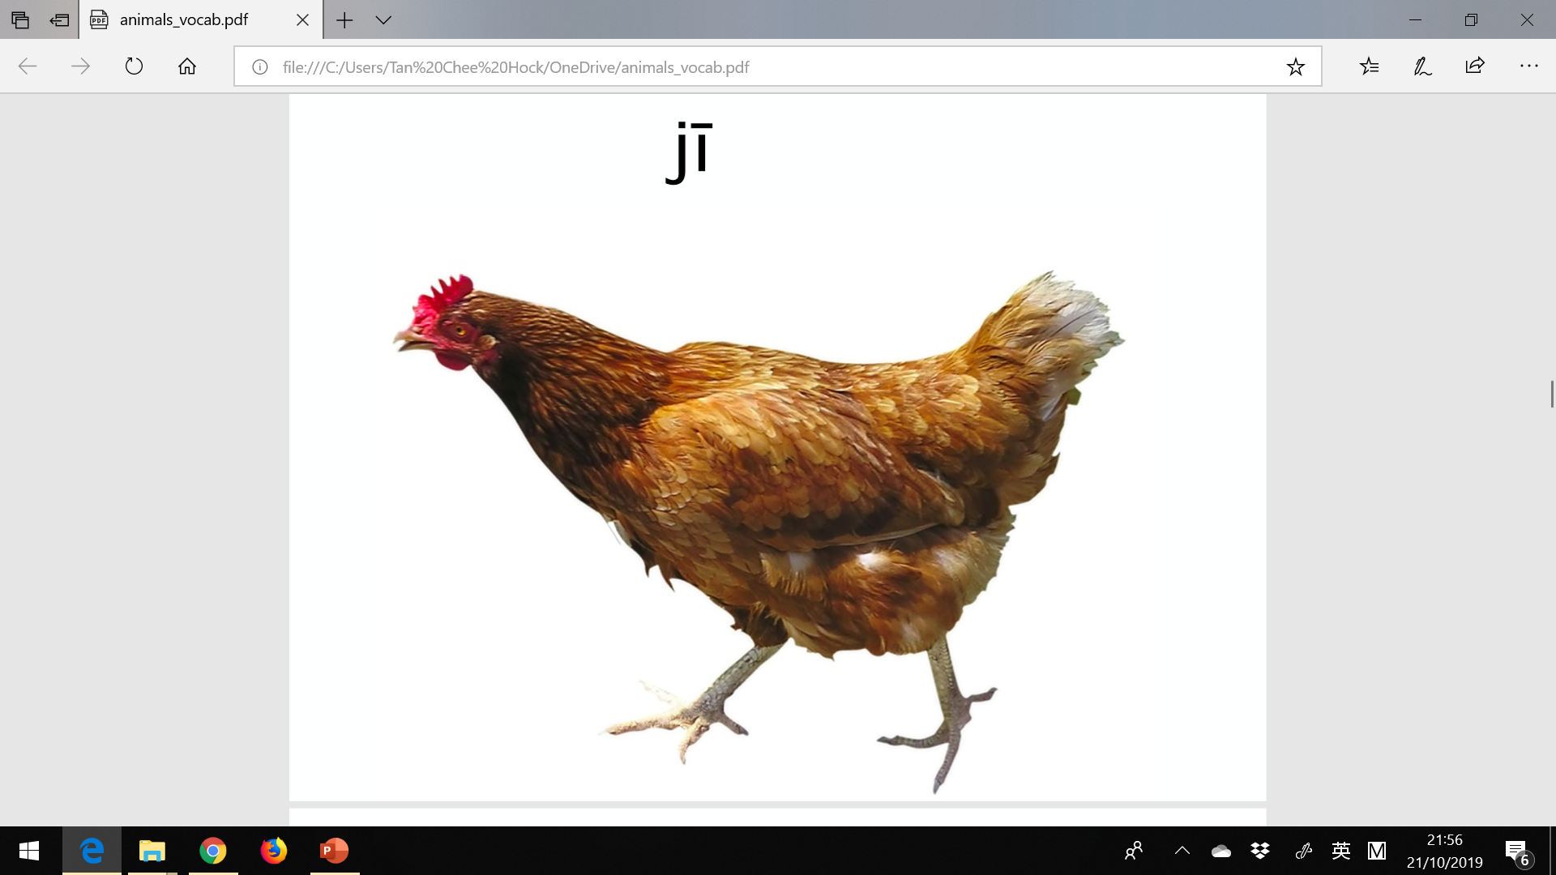

Slide 14
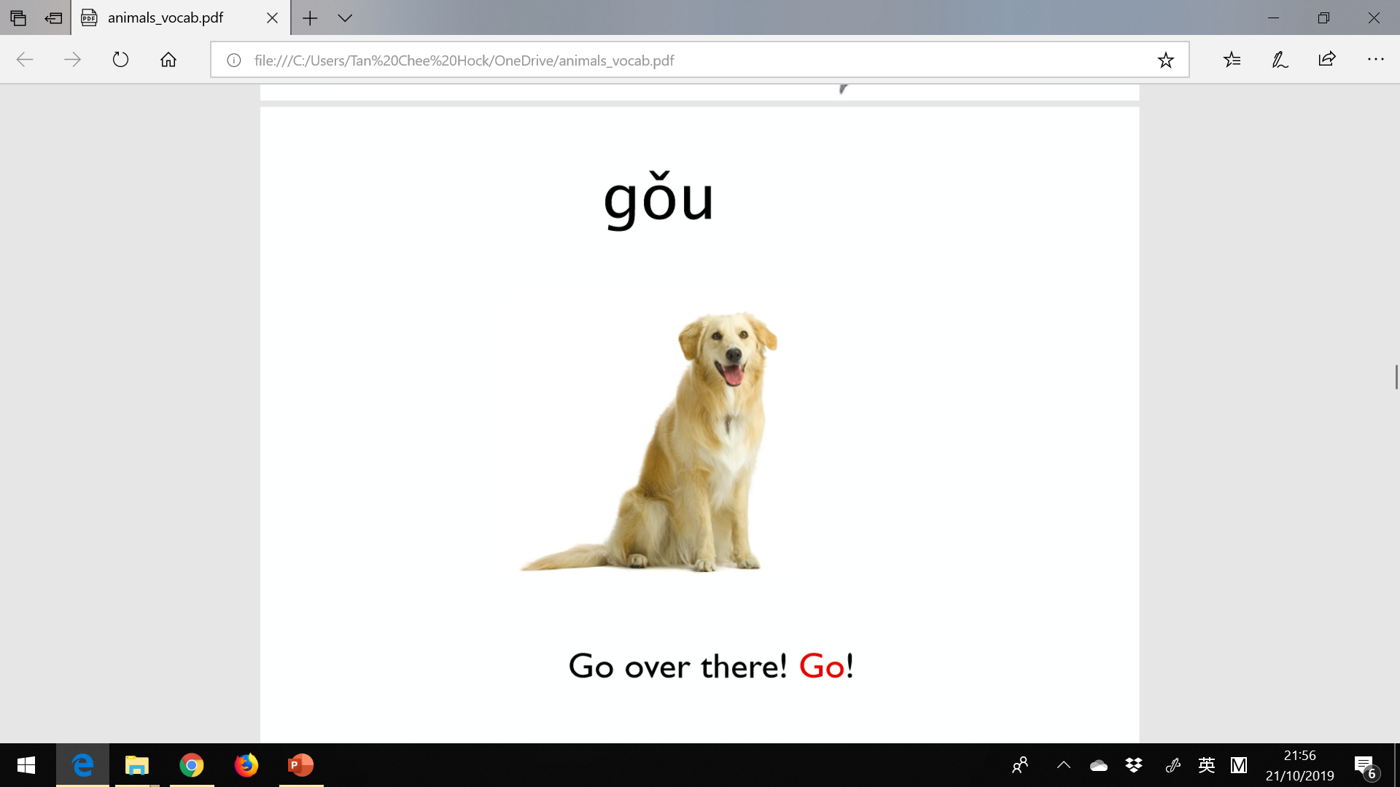

Slide 15
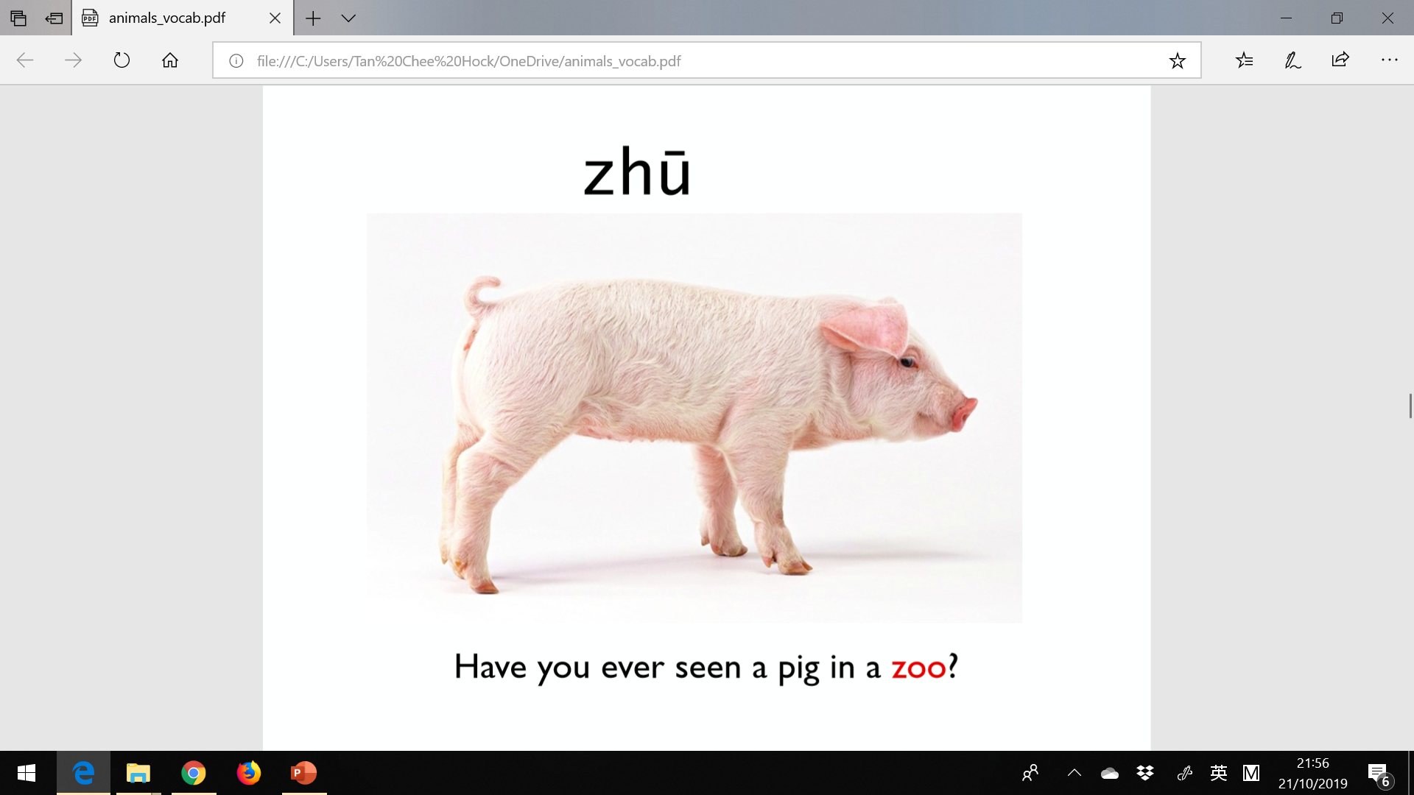

Slide 16
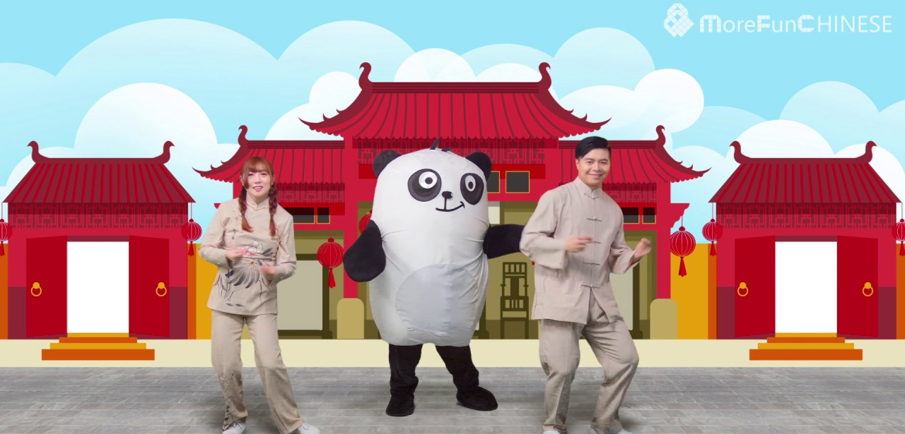

Slide 17
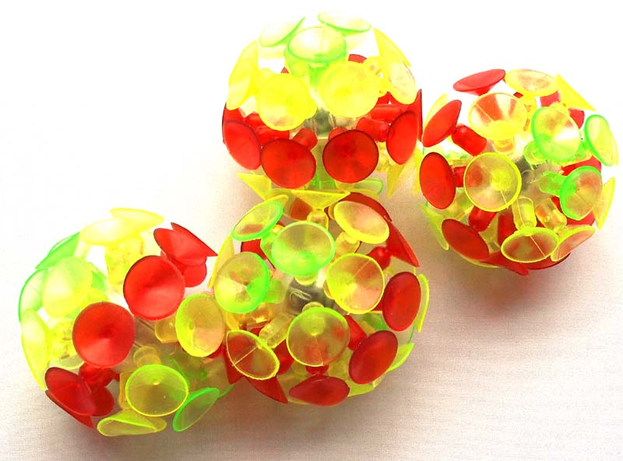
Sticky Ball

Slide 18


Slide 19
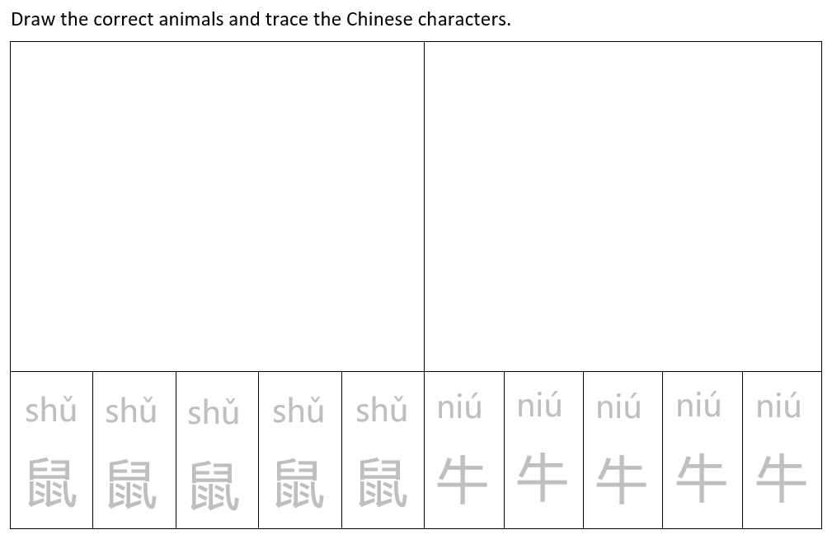
Write & Draw
Tran – Year 2

Slide 20
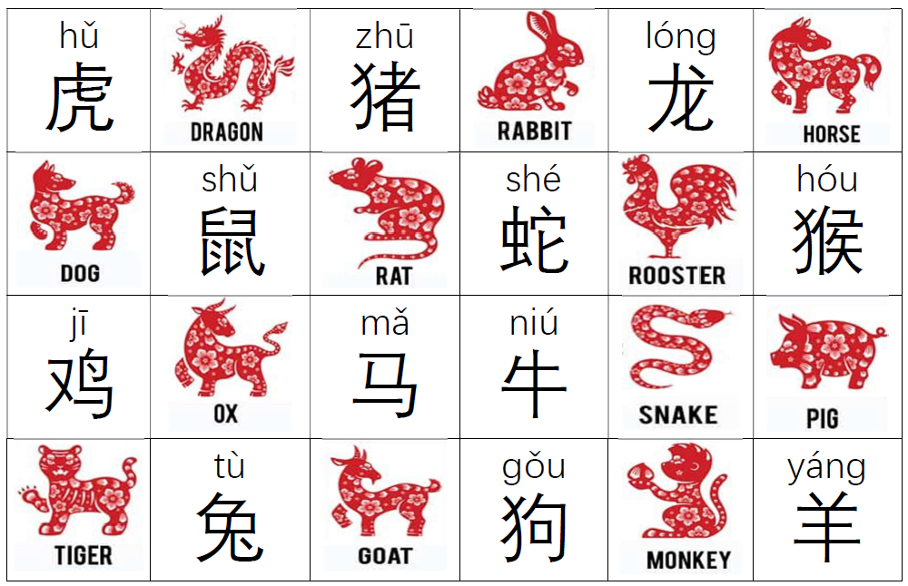
Cut & Match
Year 3 - 6

Slide 21

MINECRAFT: Education Edition
《我的世界》

Slide 22
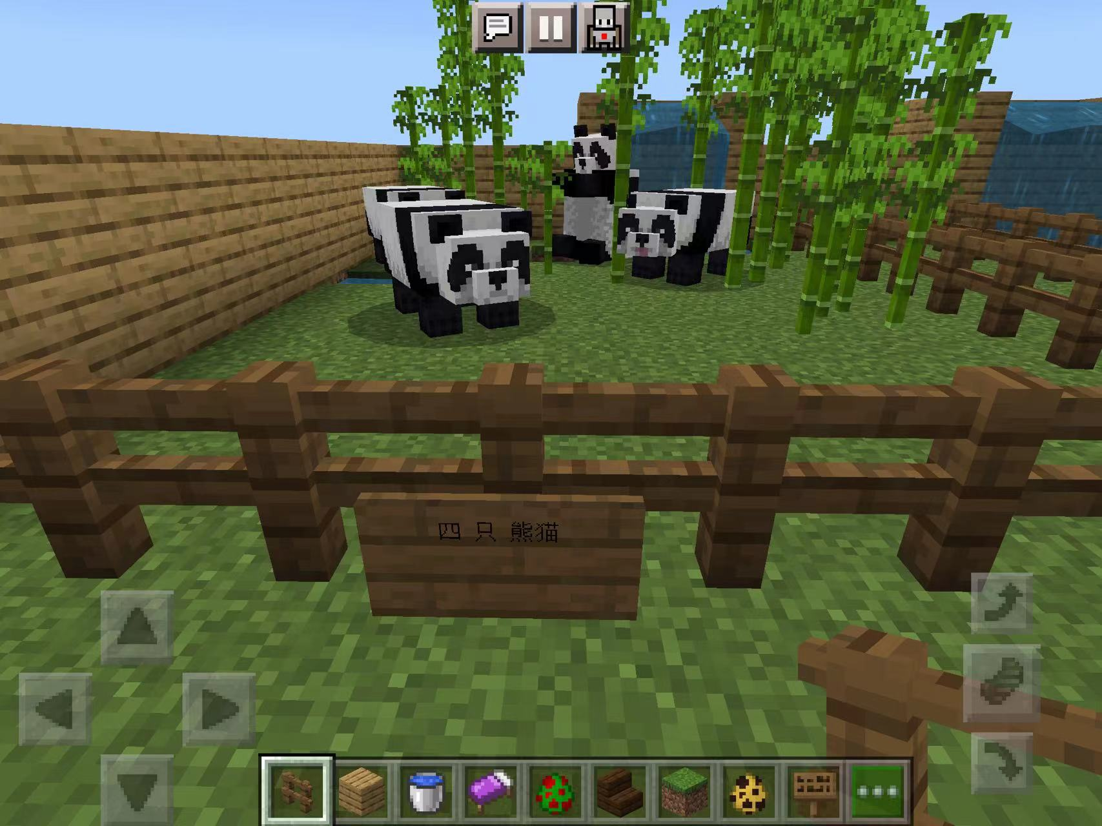
Notes:
https://app.seesaw.me/pages/shared_item?item_id=item.4d7c35a3-2ac1-4a4e-84dc-6bd75218122d&share_token=Ys3-ghNFRxKP9aZhMxaXSg&mode=share

Slide 23
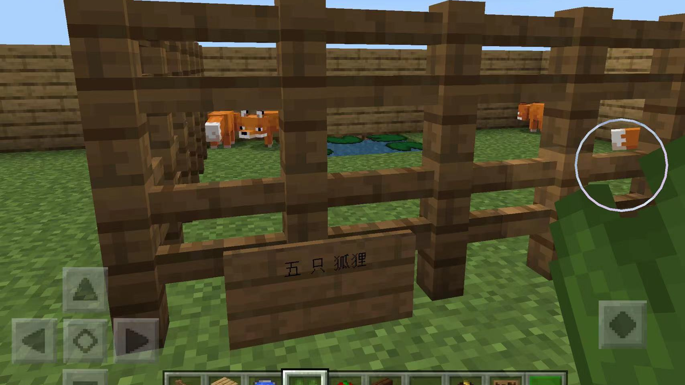

Slide 24
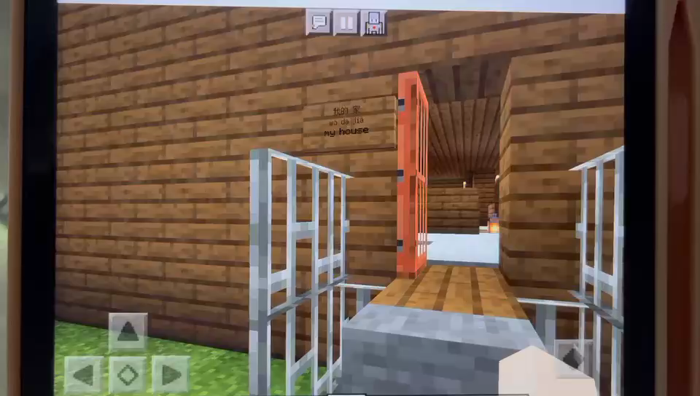
Notes:
https://ntschoolsau-my.sharepoint.com/personal/yanfang_zhuang_ntschools_net/_layouts/15/stream.aspx?id=%2Fpersonal%2Fyanfang%5Fzhuang%5Fntschools%5Fnet%2FDocuments%2Fminecraft%2F20221207%5F050543000%5FiOS%2Emov&ga=1

Slide 25
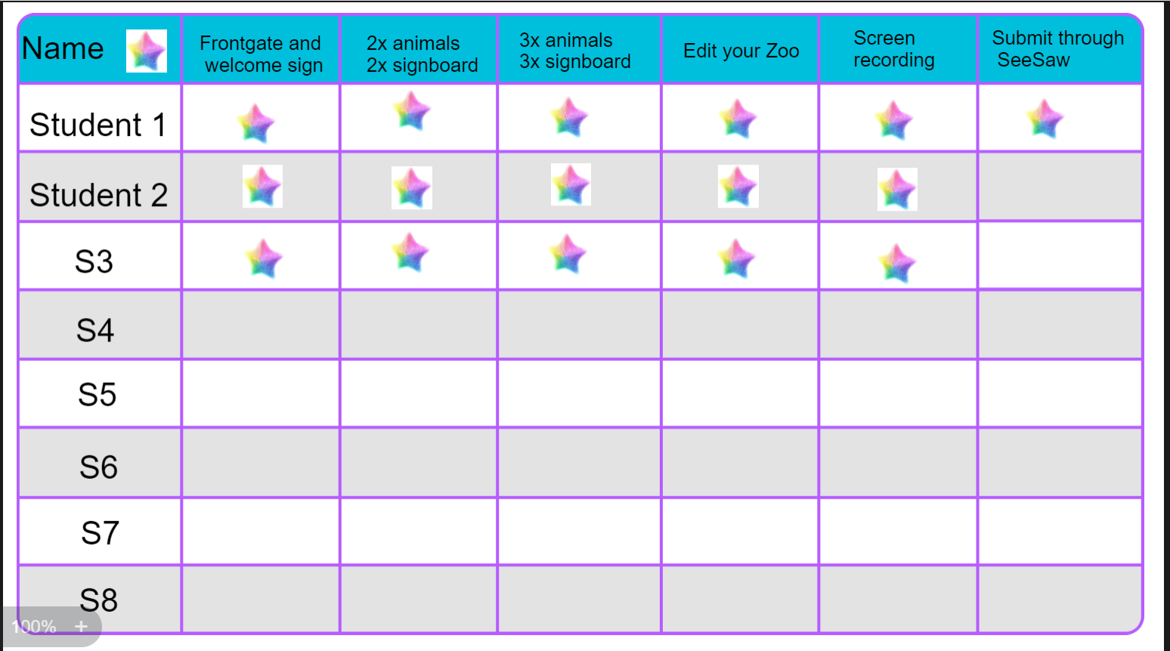
Notes:
https://suite.smarttech.com/share/c0e5ddb3-5f95-4548-8611-aedbbcc808fe

Slide 26
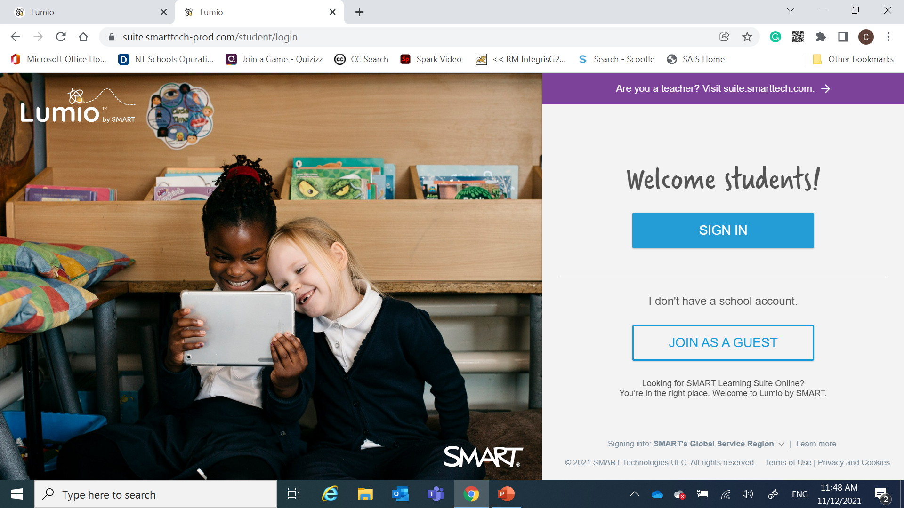
Notes:
https://www.smarttech.com/en/lumio

Slide 27


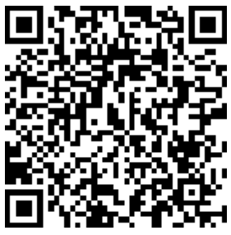
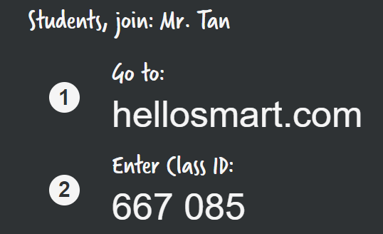

Slide 28
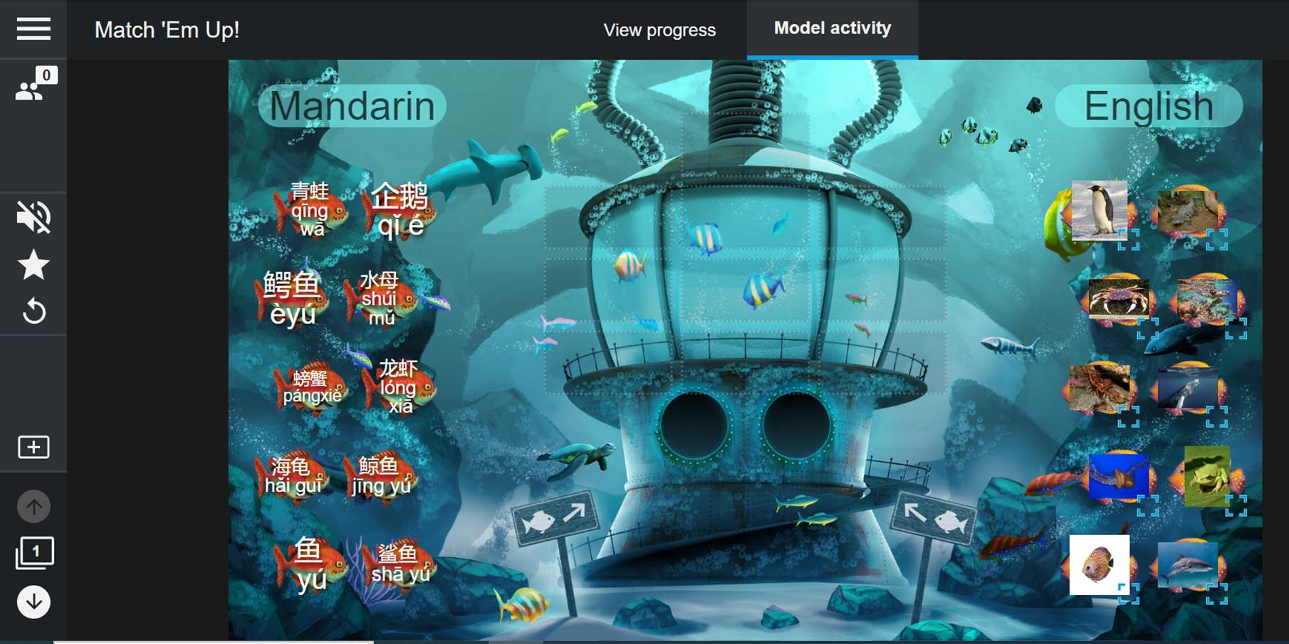
Lumio by smart: 海洋动物
Notes:
https://suite.smarttech.com/share/70e746bd-d6db-45de-9485-4d207d3b7530

Slide 29
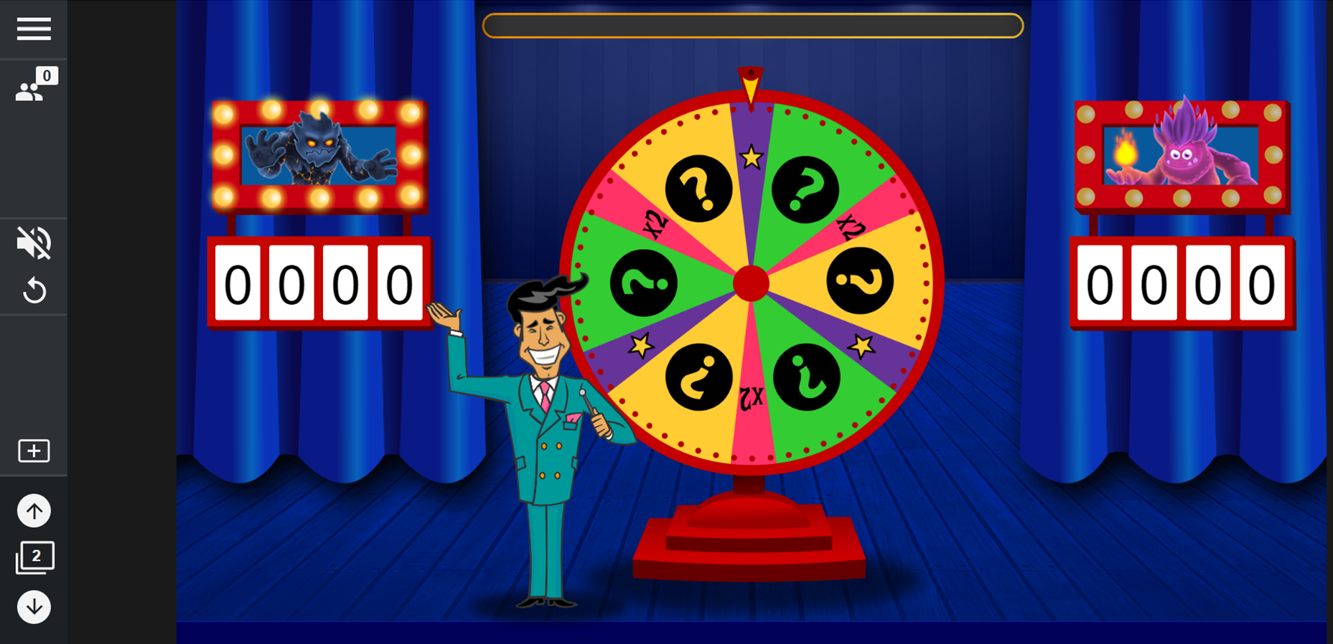
Lumio by Smart: 12 Zodiacs
Notes:
https://suite.smarttech.com/share/d5ced273-e6fc-4ace-bb5f-ca86499c96d4

Slide 30
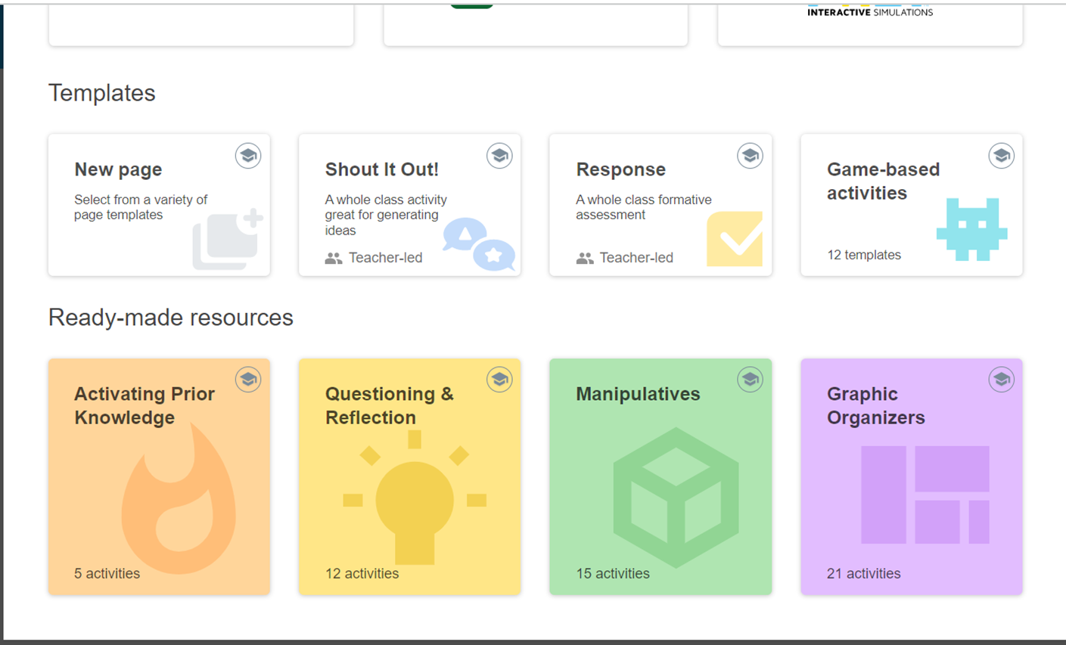

Slide 31
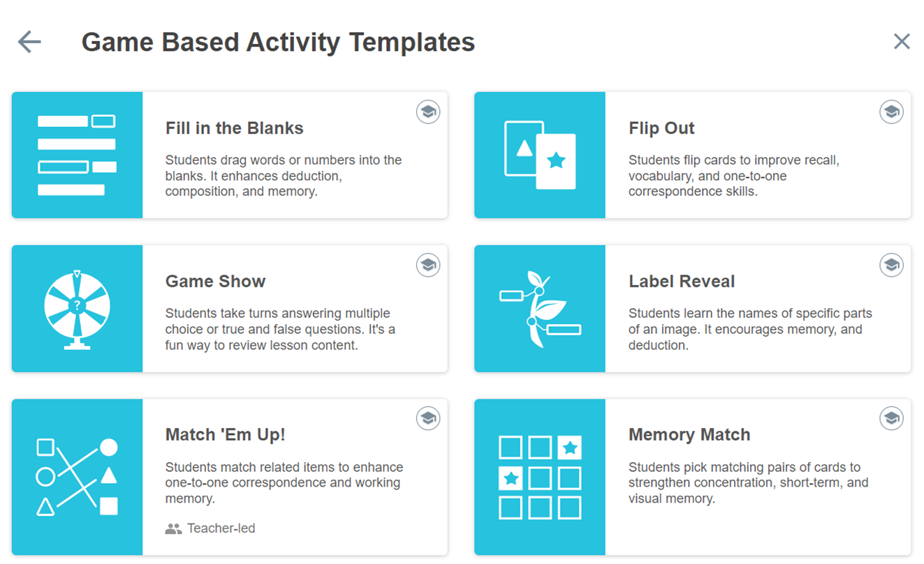
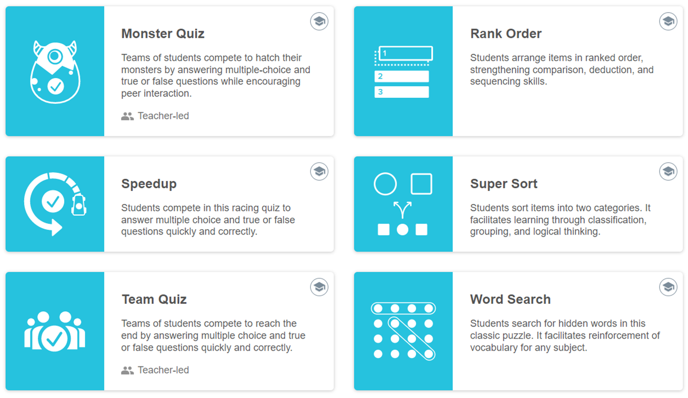


Slide 32
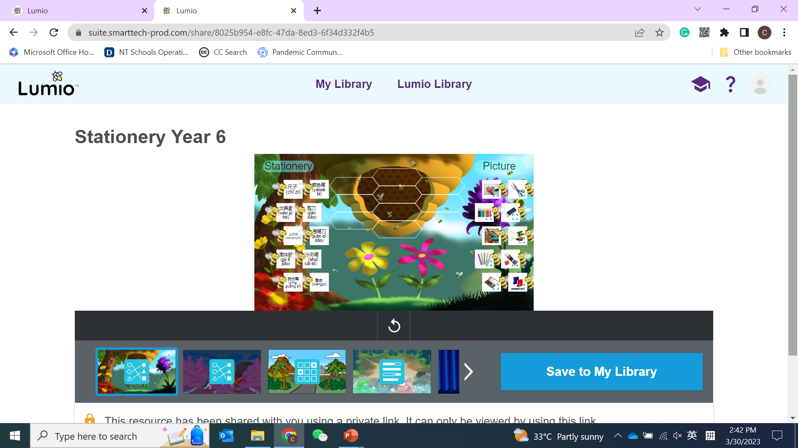
Notes:
https://suite.smarttech-prod.com/share/8025b954-e8fc-47da-8ed3-6f34d332f4b5

Slide 33

Thank you
感 谢 垂 听 ！

